Slide 1


End-user quality of service and experience in mobile networks Dissertation of Integrated Master in Computer Engineering and Telematics
Tomás Marques Rodrigues
Advisor: João Paulo Barraca
DETI, 27 July 2017

Slide 2


Contents
ArQoS Pocket Implementation
Management System Connection
ArQoS Pocket UI
Tests Implementation
Radiologs/Scanlogs
Results
Conclusions and Future Work
Main Goals
Context
Requirements
ArQoS Pocket Architecture
Introduction | Objectives and Requirements | ArQoS Pocket Solution | Conclusions and Future Work

Slide 3


Main Goals
Collect QoS, QoE and performance data from the network
Actively and passively perform network and service tests
Detect and help to troubleshoot network and service problems
Introduction | Objectives and Requirements | ArQoS Pocket Solution | Conclusions and Future Work

Slide 4


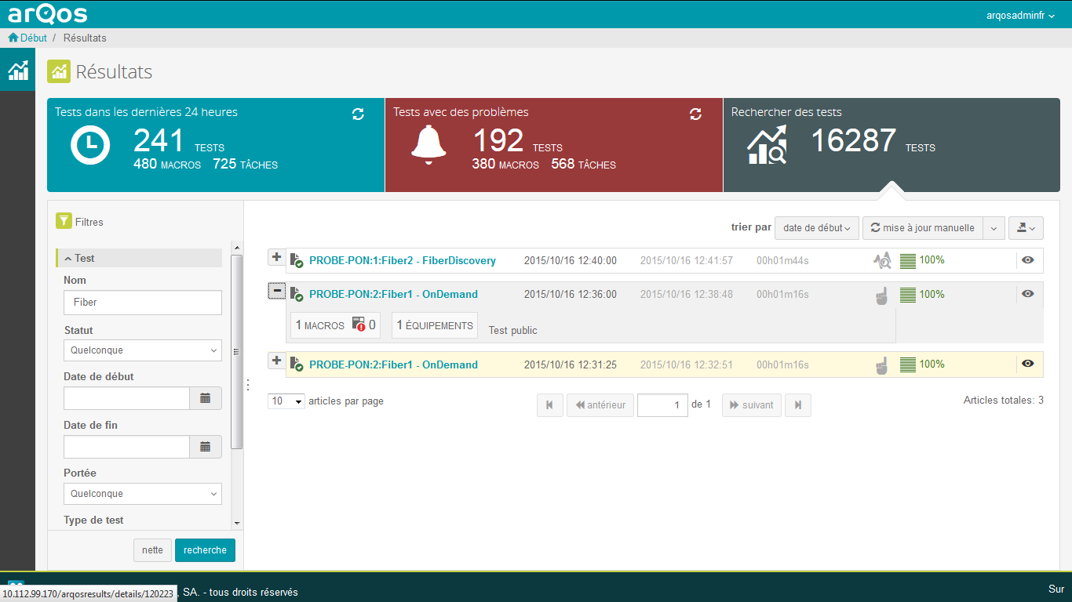
Context ArQos
ArQoS
6,5 million active tests per month
(voice, data, sms,...)
10 million measures of network
coverage/month
80 million client calls/month
monitored for VoIP at PTP
ArQoS is a Performance Monitoring System that evaluates quality of service and quality of experience on multi-technology fixed and mobile networks (Mobile, Wireless, FTTx, Ethernet and IP).
Introduction | Objectives and Requirements | ArQoS Pocket Solution | Conclusions and Future Work
Notes:
8,5 milhões de testes por mês
10 milhões de mdedidas por mês
80 milhões de chamadas por mês

Slide 5
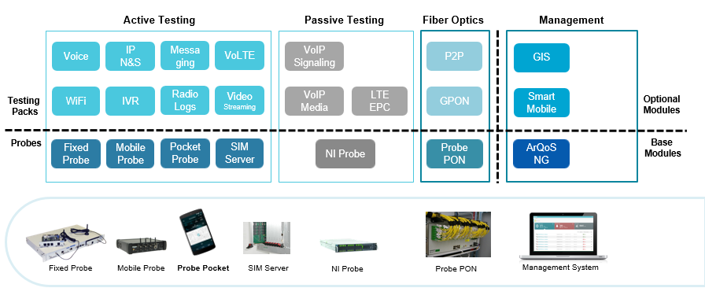
Context ArQoS Portfolio
Introduction | Objectives and Requirements | ArQoS Pocket Solution | Conclusions and Future Work

Slide 6
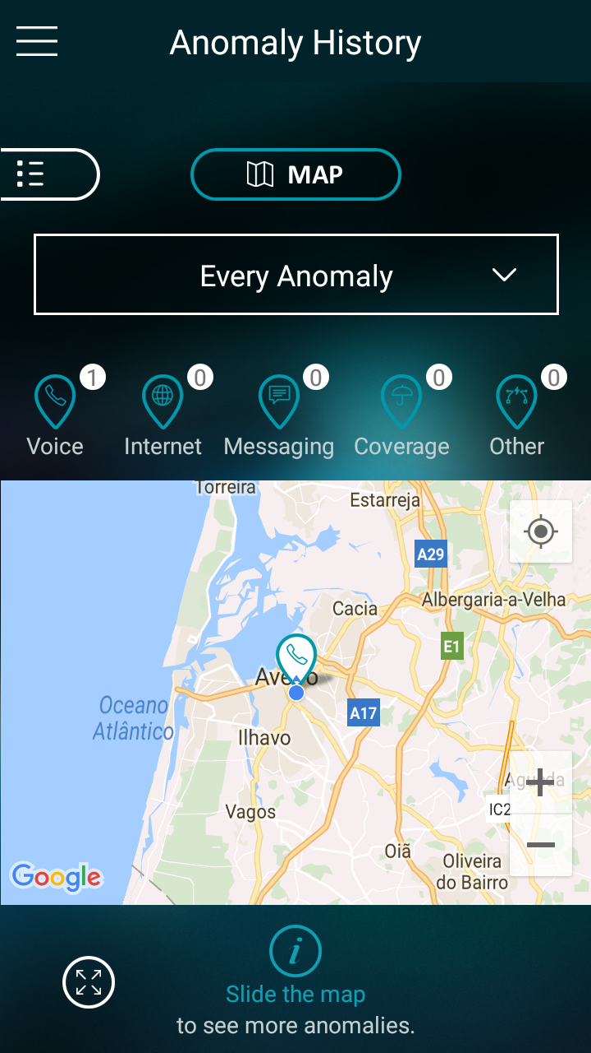
Context ArQoS Pocket Probe advantages
Data collection in a larger scale
Accurate network performance vision
Perform network tests at user request
Accelerate network troubleshooting
Introduction | Objectives and Requirements | ArQoS Pocket Solution | Conclusions and Future Work

Slide 7
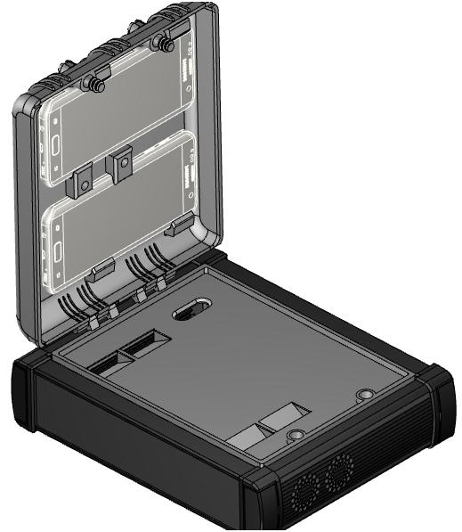
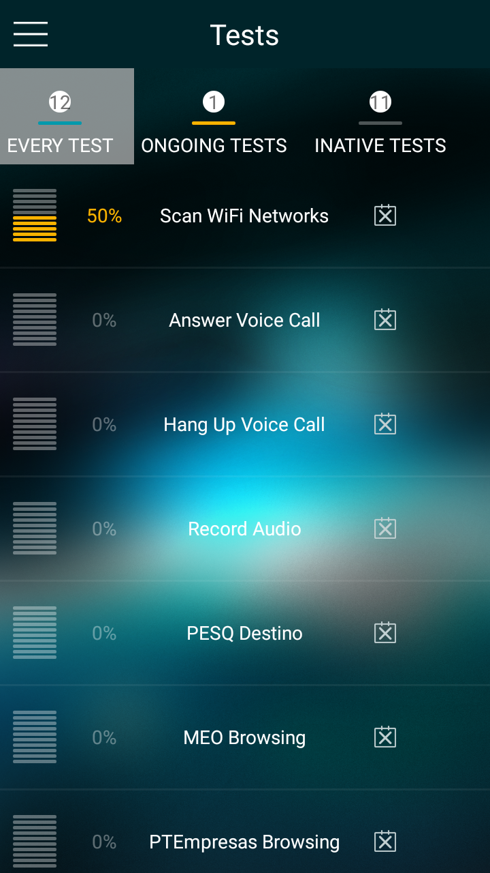
Context Deployment Scenarios
2
1
Introduction | Objectives and Requirements | ArQoS Pocket Solution | Conclusions and Future Work
Notes:
Google’s Play Store, $25 uma única vez.
Apple’s App $99 por ano
---
Portabilidade para mobile OS Symbian, Ubuntu, and Blackberry e Chrome OS
--
Java usado linguagem usada também em sistemas operativos Linux ou Windows ao contrário de Objective C ou Swift

Slide 8
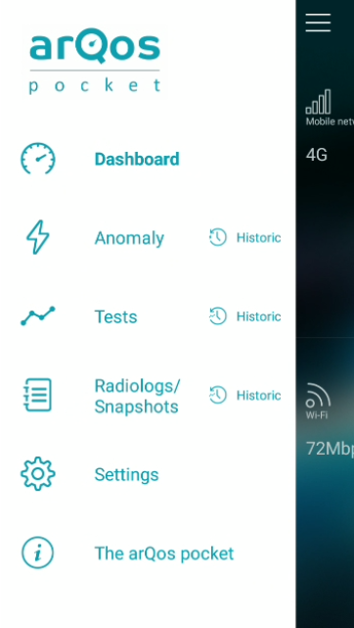
Requirements
What’s new?
Database implementation
Local storage of anomalies, tests, radiologs
Added new network tests
Test Scheduling
Management System Connection
Radiologs/Scanlogs feature
New Settings configurations
App launch at the device boot
Dashboard Page
Anomaly Reports
Base Tests
PING, Portal Login,
HTTP Download/Upload
Settings Page
Homepage and Language
Introduction | Objectives and Requirements | ArQoS Pocket Solution | Conclusions and Future Work

Slide 9
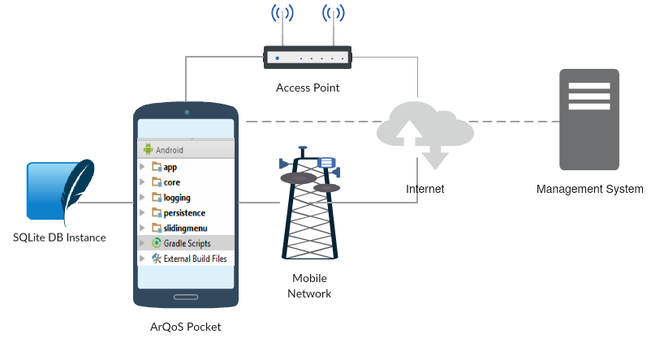
ArQoS Pocket Architecture
Introduction | Objectives and Requirements | ArQoS Pocket Solution | Conclusions and Future Work
Notes:
Falar de sharedPreferences para SQLite database 25 a 40% de ganho em tempo de carregamento das páginas de histórico

Slide 10
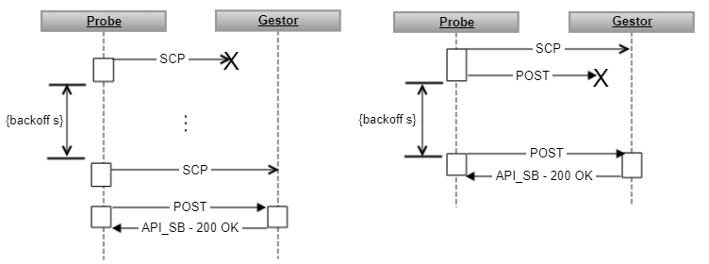
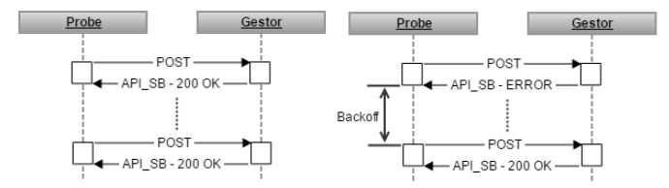
Management System Connection
Notifications:
Auto-Discovery
Keep-Alives
Results-process
IP-update-process
Attach-files-process
Radiologs/Scanlogs-files-process
Introduction | Objectives and Requirements | ArQoS Pocket Solution | Conclusions and Future Work
Notes:
Auto-discovery: "probenotification":{"equipmenttype":"13","ipaddress":"10.112.200.140","macaddress":"357810081051139","msg_type":0,"serialnumber":"357810081051139","timestamp":"20170725173754“
Ip-update: old ip address, new ip address

Slide 11
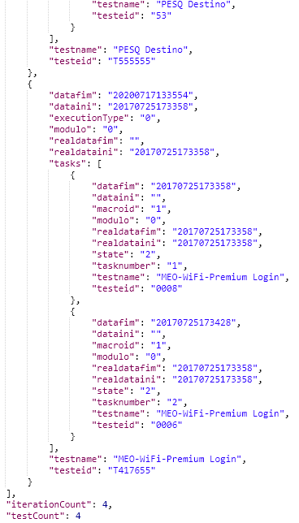
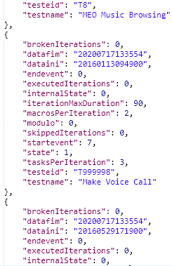
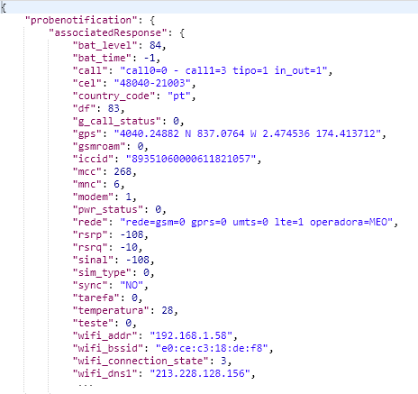
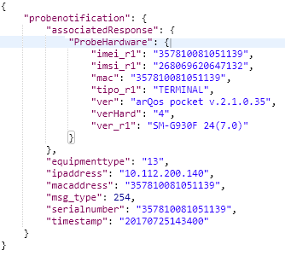
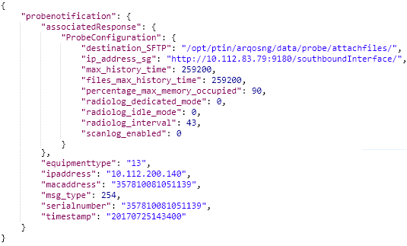
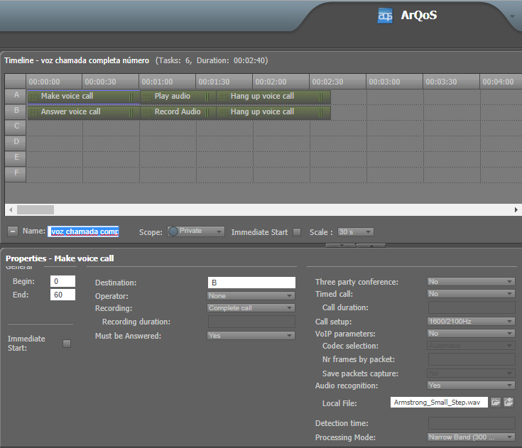
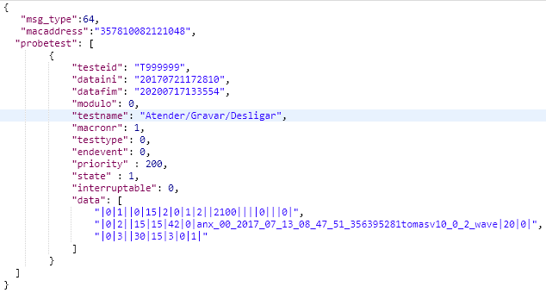
Management System Connection
Requests:
Get Probe Information
Get Probe Configurations
Get Probe state
Get Probe ocupation by date
Get Probe Load tests
Change Probe Configurations
Schedule a Test
Cancel a Test
Introduction | Objectives and Requirements | ArQoS Pocket Solution | Conclusions and Future Work

Slide 12
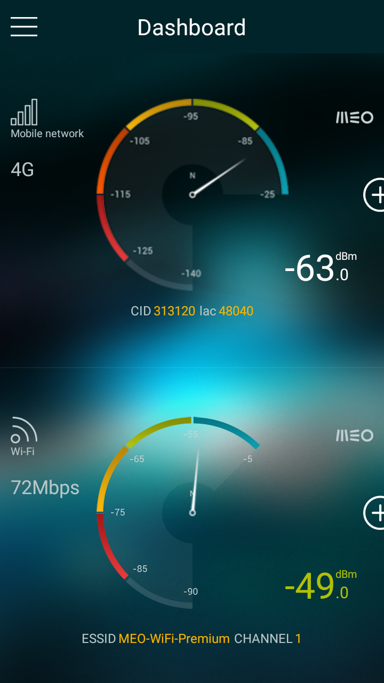
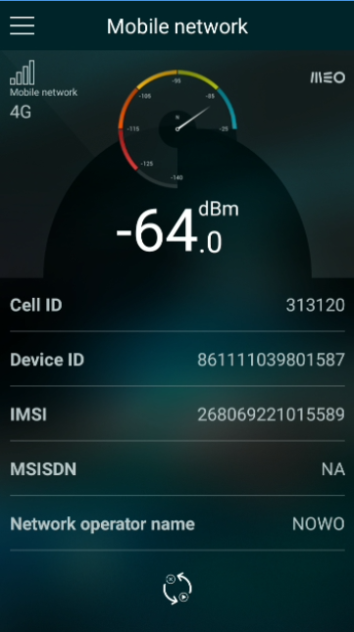
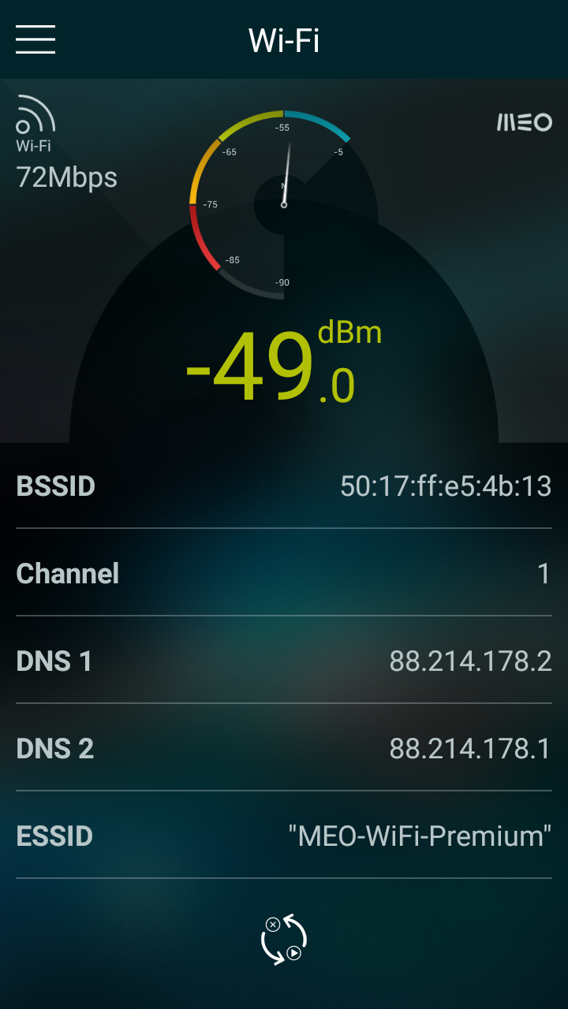
Dashboard page
Mobile Network Information:
Cell ID, Signal level
Mobile Network 2G/3G/4G Indicators
WiFi indicators
BSSID, ESSID, Channel…
IP, MAC, DNSs addresses
Detailed information per type of network
Introduction | Objectives and Requirements | ArQoS Pocket Solution | Conclusions and Future Work

Slide 13
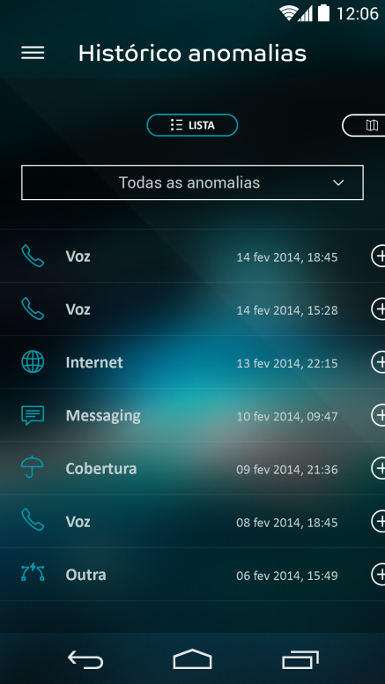
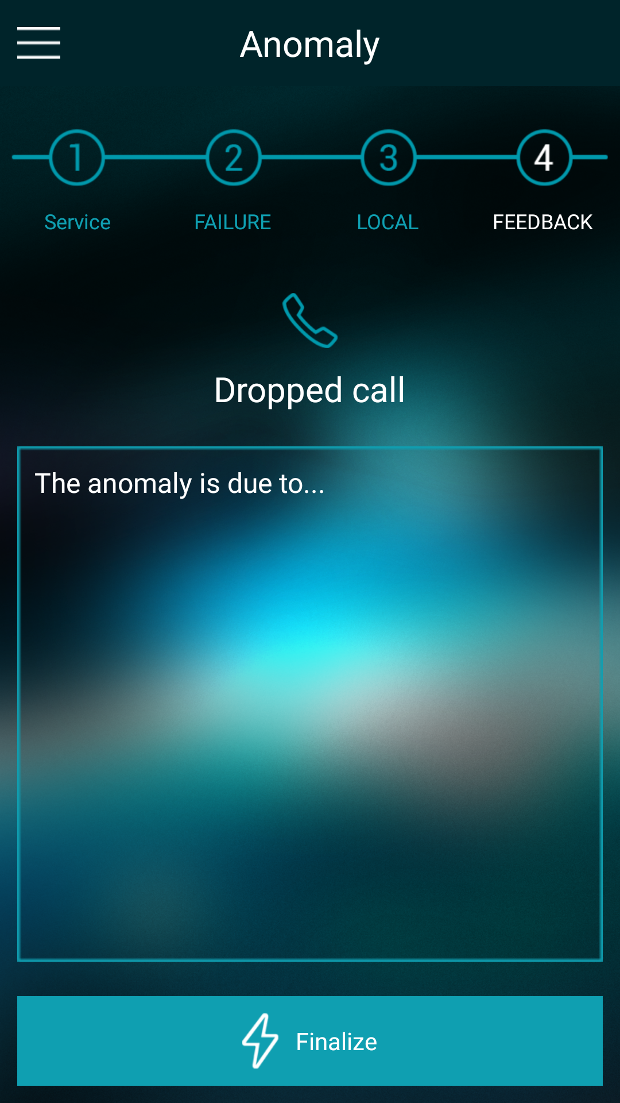
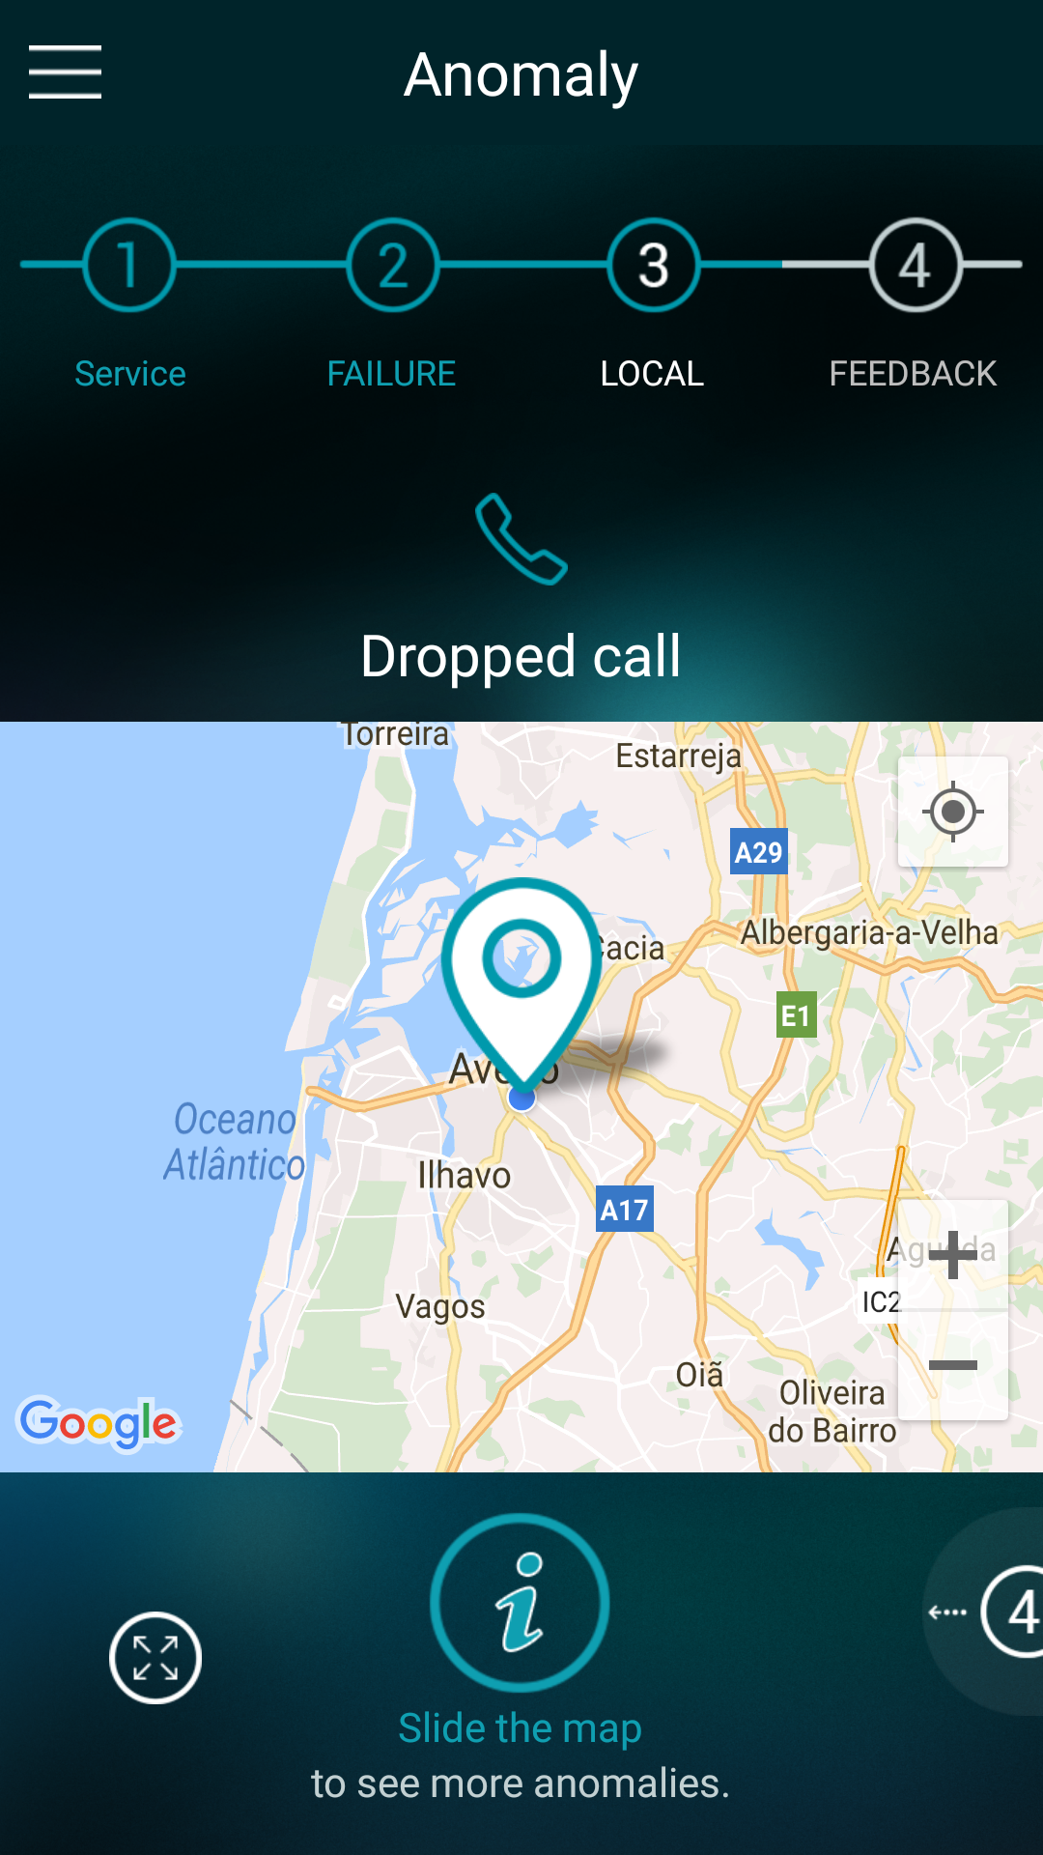
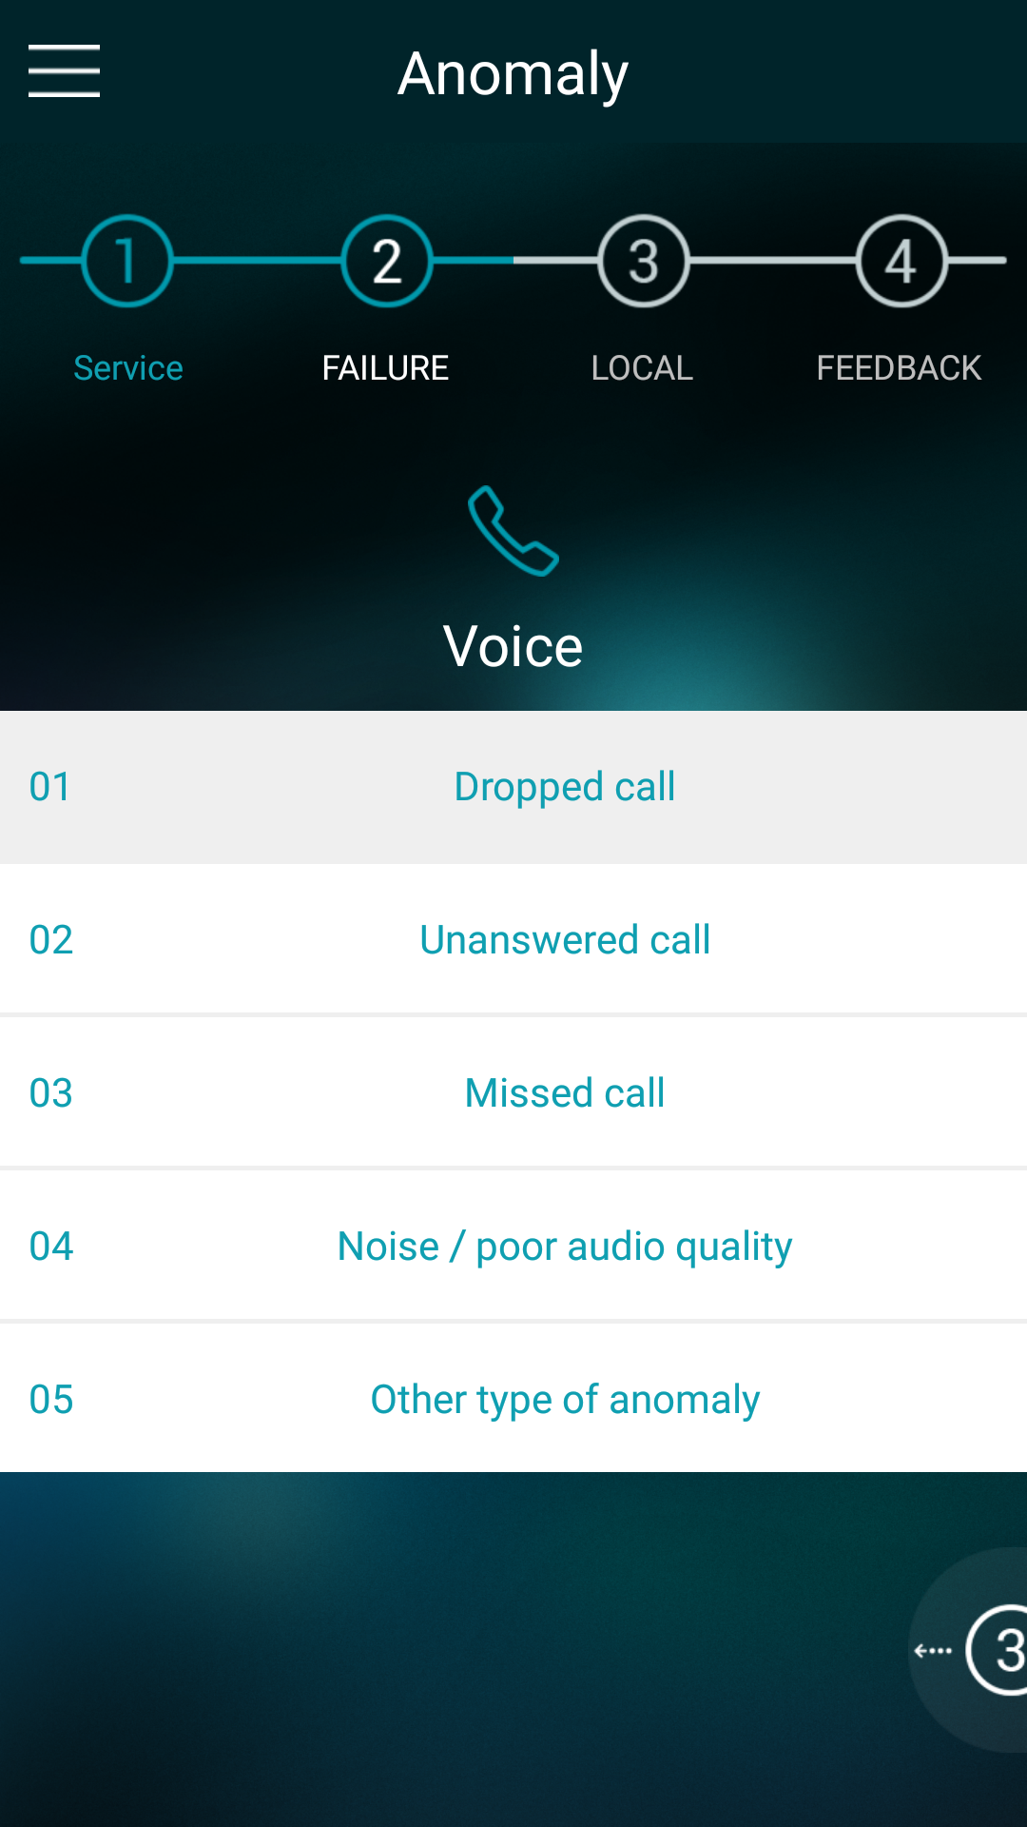
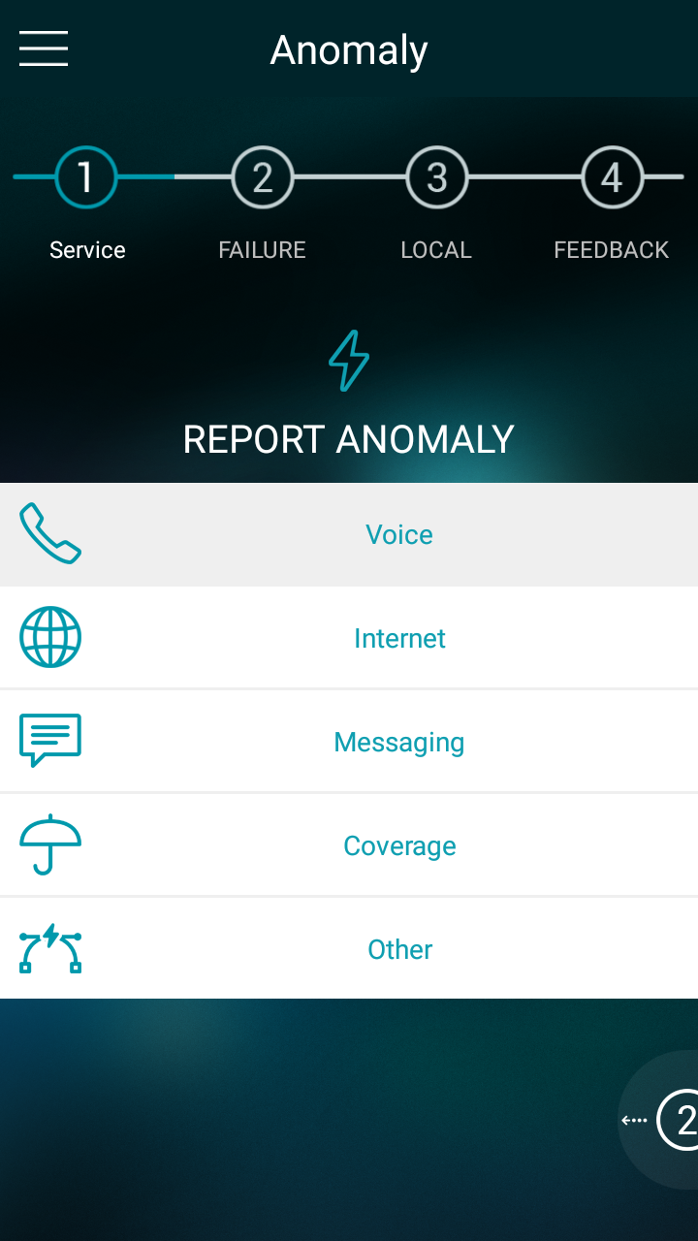
Customer Experience Report
Classified feedback:
Voice,
Internet,
Messaging
Coverage
Other (with description)
Assisted geo-location
Local record persistence with SQLite Database
Centrally stored on ArQoS Management System
Introduction | Objectives and Requirements | ArQoS Pocket Solution | Conclusions and Future Work
Notes:
Falar de sharedPreferences para SQLite database 25 a 40% de ganho em tempo de carregamento das páginas de histórico

Slide 14
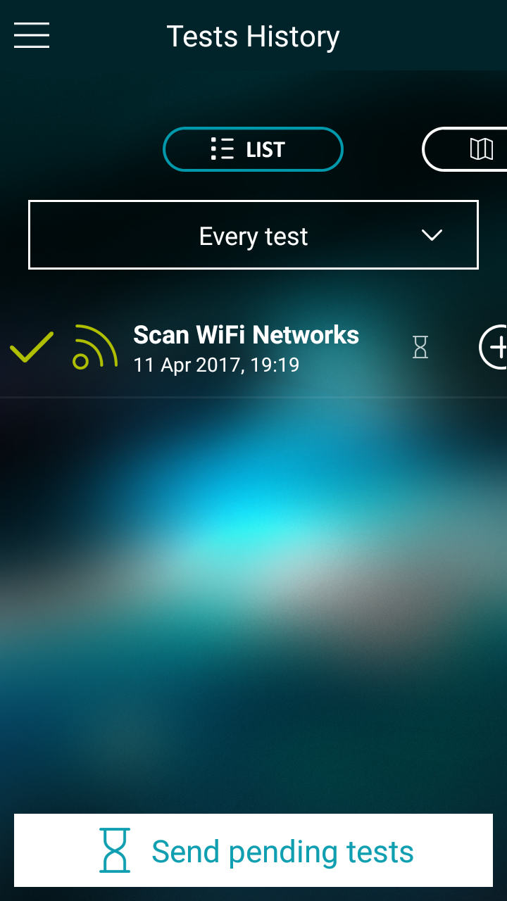
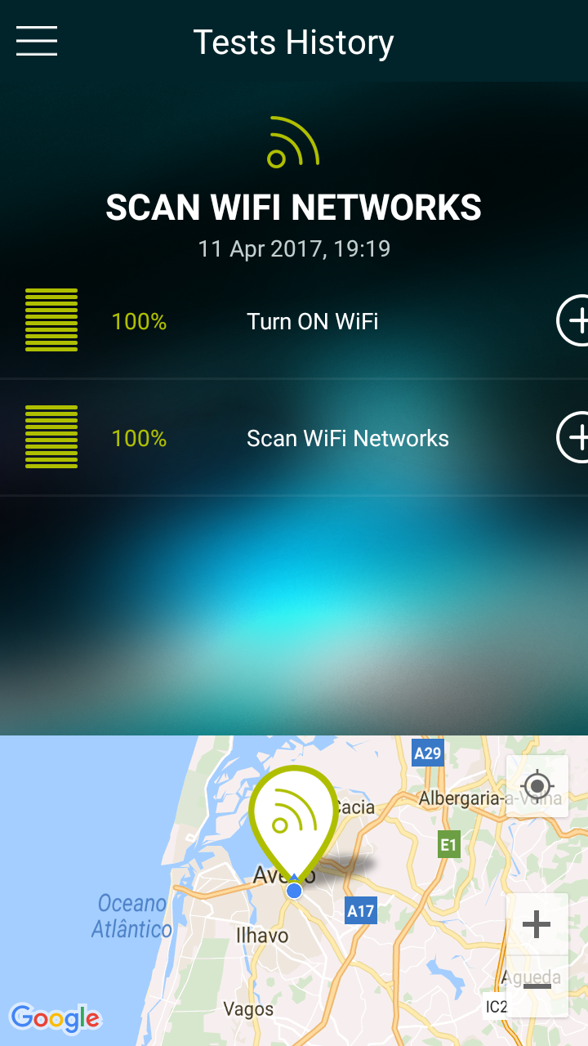
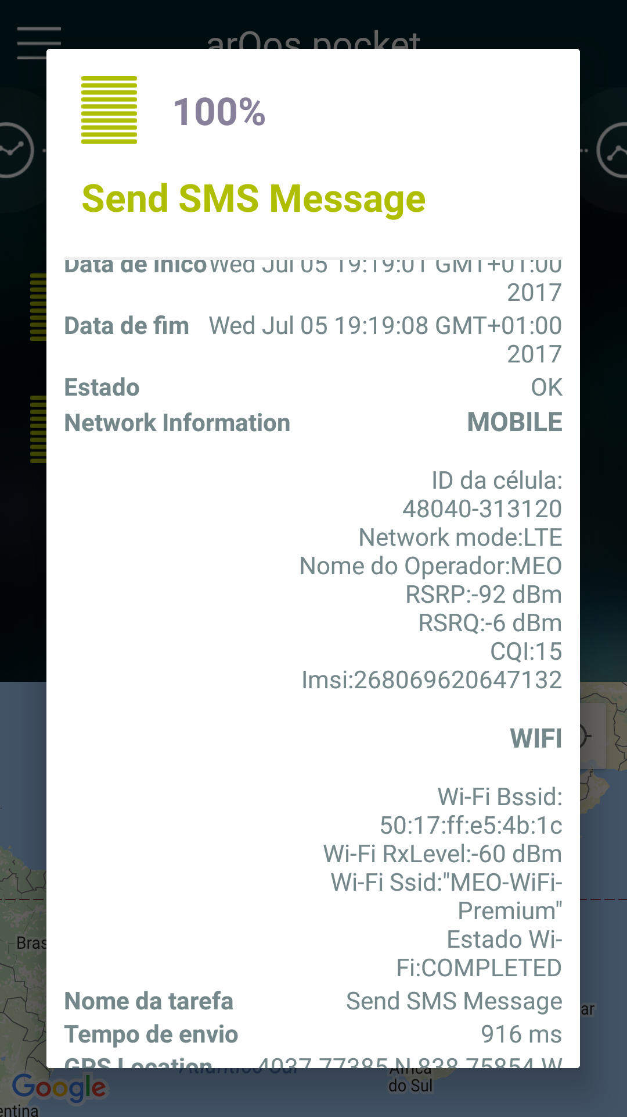
Test Implementation
Active testing with preconfigured tests available
New tests plans:
Scan Wi-Fi networks
Send DTMF Tones
Make/Receive/Record and Hang up a Voice call
SMS (Send & Receive)
Old tests plans:
Http Download/Upload
PING
WiFi authentication (Operator Specific)
Results stored centrally on ArQoS Management System
Introduction | Objectives and Requirements | ArQoS Pocket Solution | Conclusions and Future Work

Slide 15
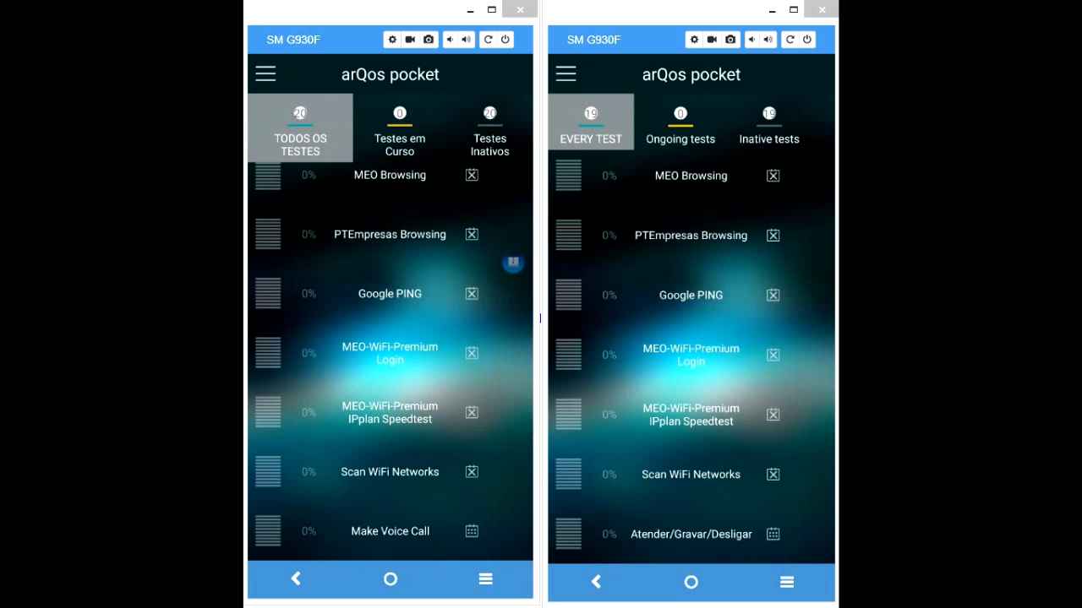
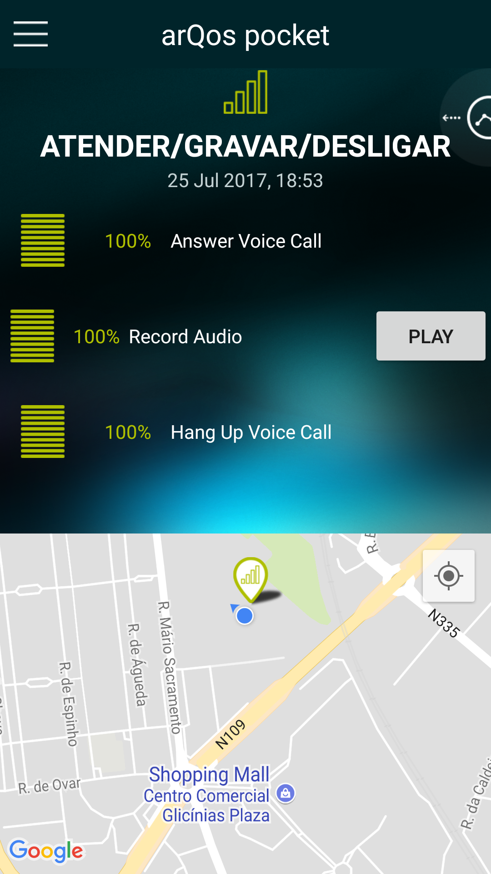
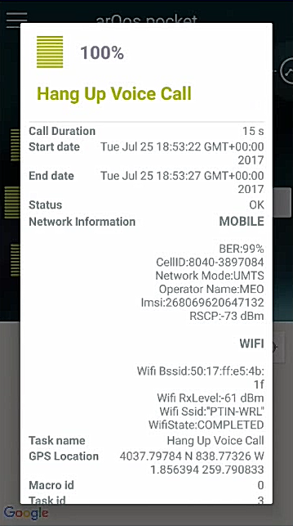
Test Implementation Voice Tests
The application needs to be a signed system app
To control the call internal proccess
Introduction | Objectives and Requirements | ArQoS Pocket Solution | Conclusions and Future Work

Slide 16
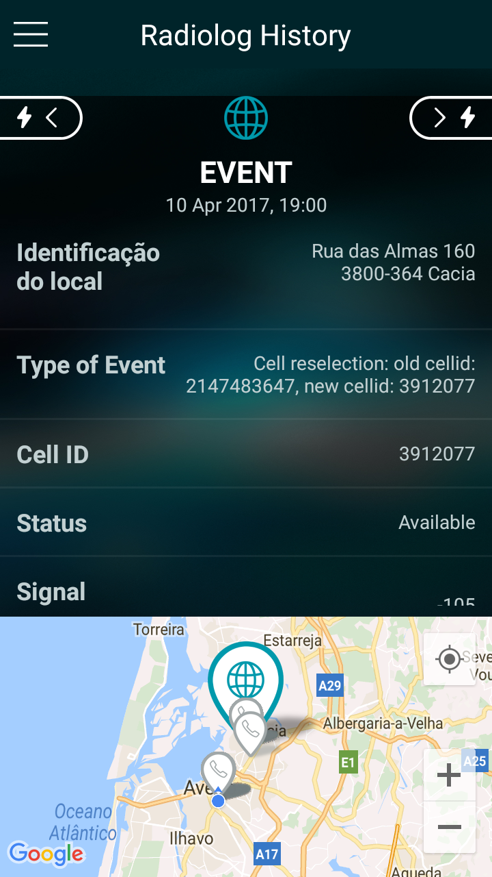
Radiologs/Scanlogs
Radiologs
(Mobile Network Snapshot)
Taken periodically with a configured interval
Detailed mobile network information
on the various technologies
Automatic events triggered
Dedicated/Idle mode
Scanlogs
(Wi-Fi Network Snapshot)
Introduction | Objectives and Requirements | ArQoS Pocket Solution | Conclusions and Future Work
Notes:
Radiologs: tirados periodicamente
parâmetros RSRP, RSRQ, CQI, PCI, BER
eventos automáticos
modo dedicado
Scanlogs: protocol gestão de chaves, and encryptação, frequencia, signal level

Slide 17
Results
Integration with the NG probes
Run in Android devices with the version 5.1 (Lolipop) or above
Gain from 25 to 40% in the load page times with the database implementation
Automatic trigger of radiolog events
Possible information to collect from the Android logs
Introduction | Objectives and Requirements | ArQoS Pocket Solution | Conclusions and Future Work
Notes:
Nem é possível instalar em dispositivos com API 14 ou inferior

Slide 18
Conclusions and Future Work
Database implementation
Added SMS and Voice tests
Test Scheduling
Management System Connection
Radiologs/Scanlogs feature
New Settings features
App launch at the device boot
Improve voice tests
Integrate the Android logfile
Information
Automatic trigger scanlog events
Support new technologies like VoLTE/VoWIFI
New features like CDRs
Introduction | Objectives and Requirements | ArQoS Pocket Solution | Conclusions and Future Work
Notes:
Integrar informação do log nas anomalias, e eventos de radiologs e scanlog.
CDR’s = Call Data Record toda a informação de uma chamada

Slide 19
References
Altice Labs, “Improve Network Service Quality”, Optimize customer experience and network performance, http://www.alticelabs.com/content/products/BR_ArQoS_ALB_EN.pdf.
IDC, “Smartphone OS Market Share, 2017 Q1.” 2017 [Online]. Available: http://www.idc.com/pr
omo/smartphone-market-share/os.
S. Hill, “Which smartphone OS wins 2016?” 2016. [Online]. Available: https://www.digitaltrends.
com/mobile/best-smartphone-os/.
Introduction | Objectives and Requirements | ArQoS Pocket Solution | Conclusions and Future Work

Slide 20
The end
Thank you
for your attention!
Introduction | Objectives and Requirements | ArQoS Pocket Solution | Conclusions and Future Work

Slide 21

Questions?
Introduction | Objectives and Requirements | ArQoS Pocket Solution | Conclusions and Future Work

